Slide 1
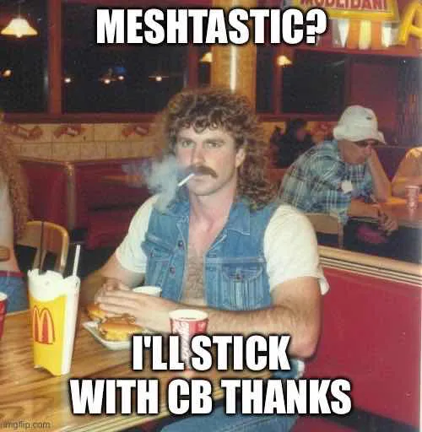
DC Mesh
Presentation to HacDC Amateur Radio Club in Washington, D.C. (W3HAC.org)
Wednesday, April 2nd, 2025
MLK Library, Washington, DC
Will Martin
KC2ZZR

Slide 2
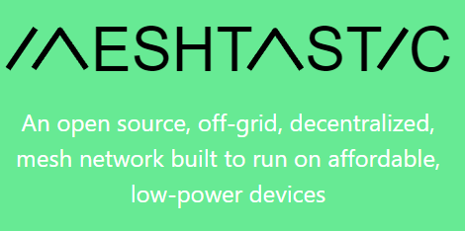
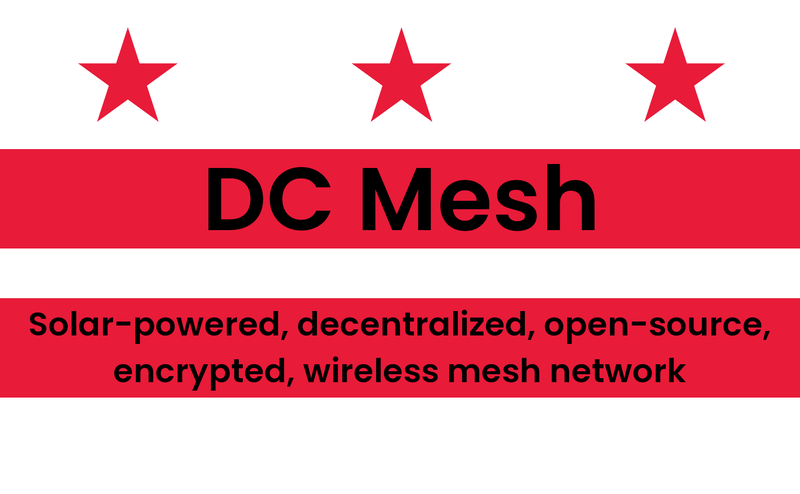
Meshtastic and DC Mesh
Meshtastic is the software
Meshtastic is the global open-source software/firmware project
Started in 2020 by Kevin Hester
9000+ commits on GitHub from 100+ contributors
DC Mesh is the club
Our goal is to deploy solar-powered Meshtastic repeaters around Washington DC
Open to anyone (licensed or unlicensed)

Slide 3
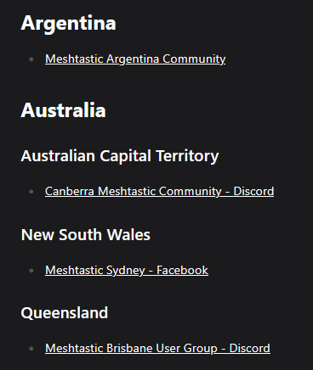
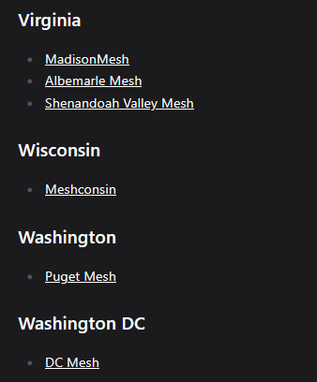
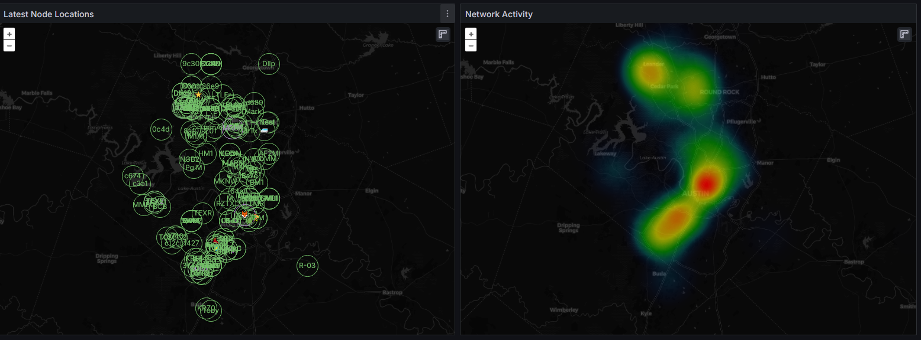
The DC Mesh Club
Precursor: Austin Mesh
Will started Ausitn Mesh in Austin, Texas in the summer of 2022 using a simple formula:
Simple goal: cover the city in solar-powered Meshtastic repeaters
Hold quarterly in-person meetings
Encourage everyone to experiment and expand the network
Reach out to like-minded groups: ham radio clubs, hacker spaces, disaster response groups, mutual aid orgs, etc.
Austin Mesh is now one of the largest US meshes:
DC Mesh
Will started DC Mesh in summer of 2024
Meshtastic is decentralized – there’s no need to join our club and our club has no control over the network.
But you should join our club to hang out with like-minded people and coordinate the build out of the network!
One of dozens of groups around the world: https://meshtastic.org/docs/community/local-groups/
graphs.austinmesh.org

Slide 4
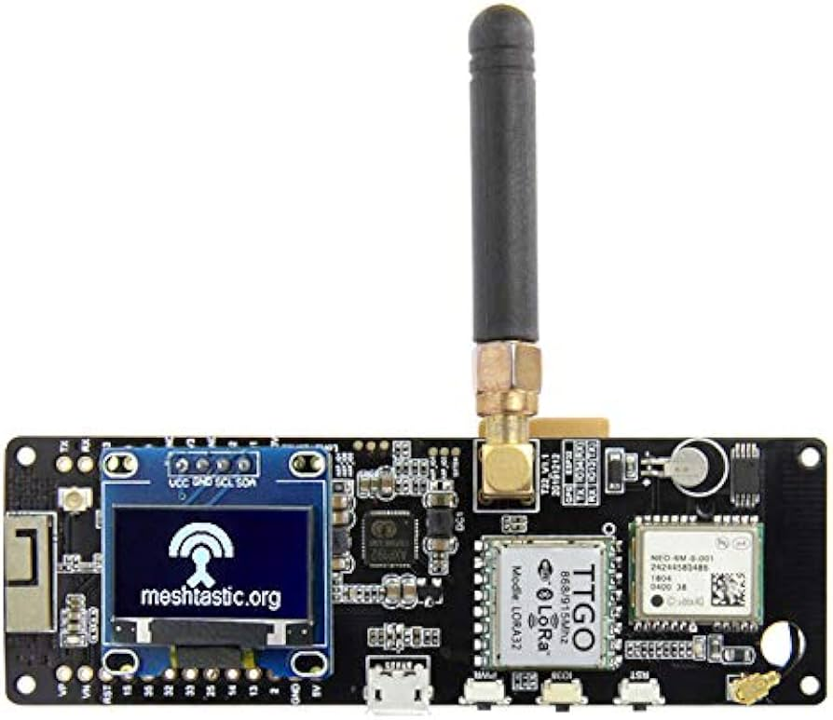
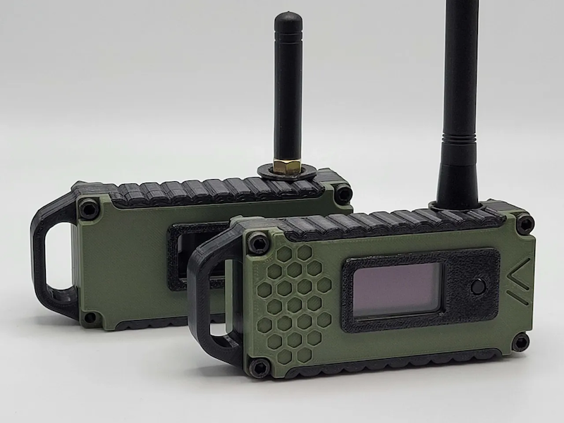

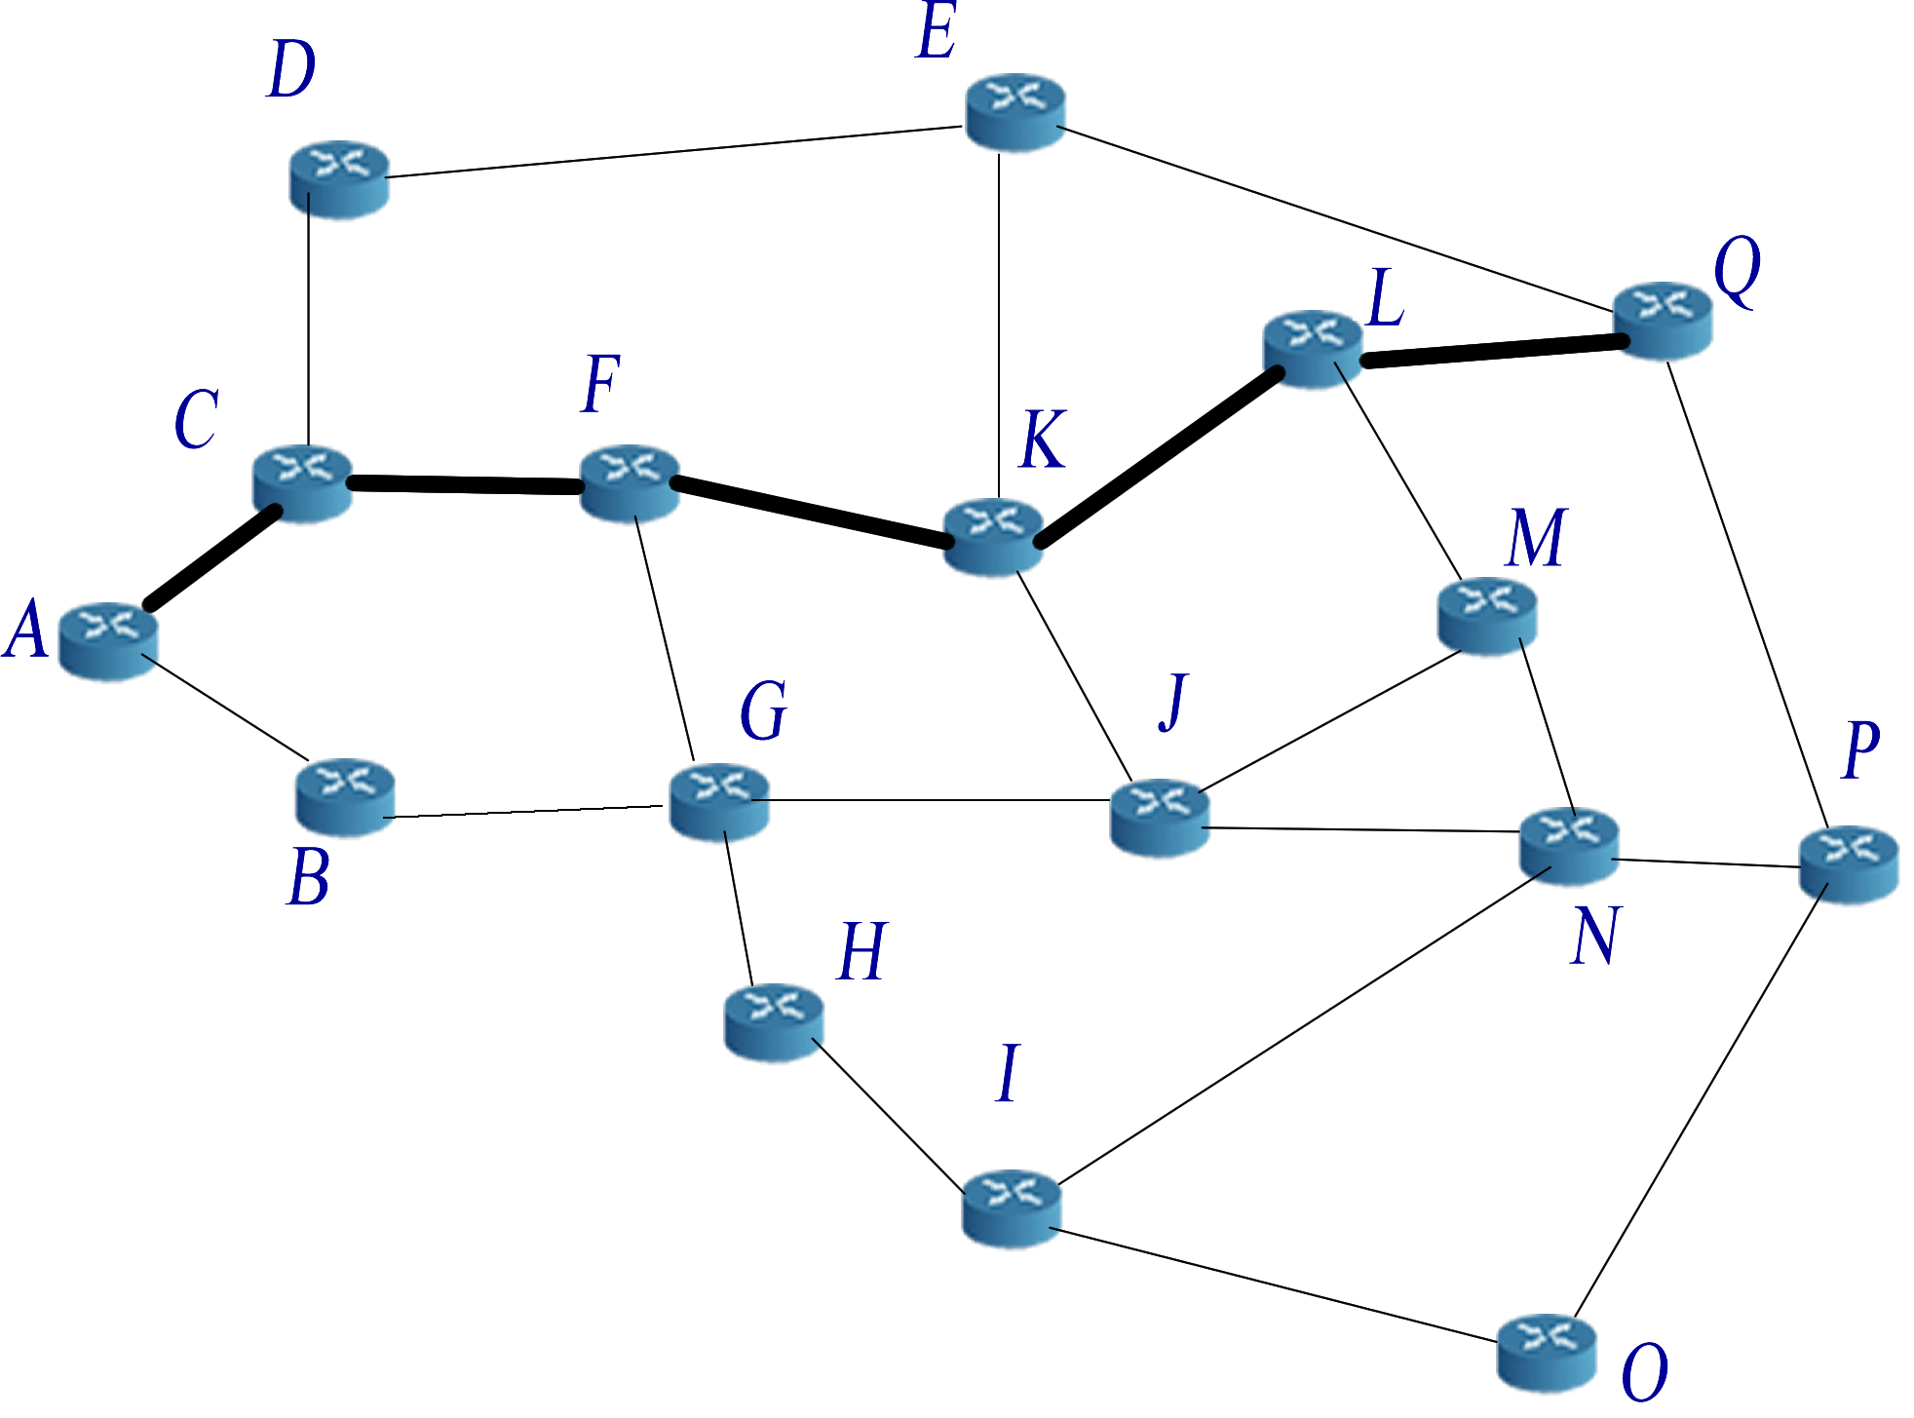
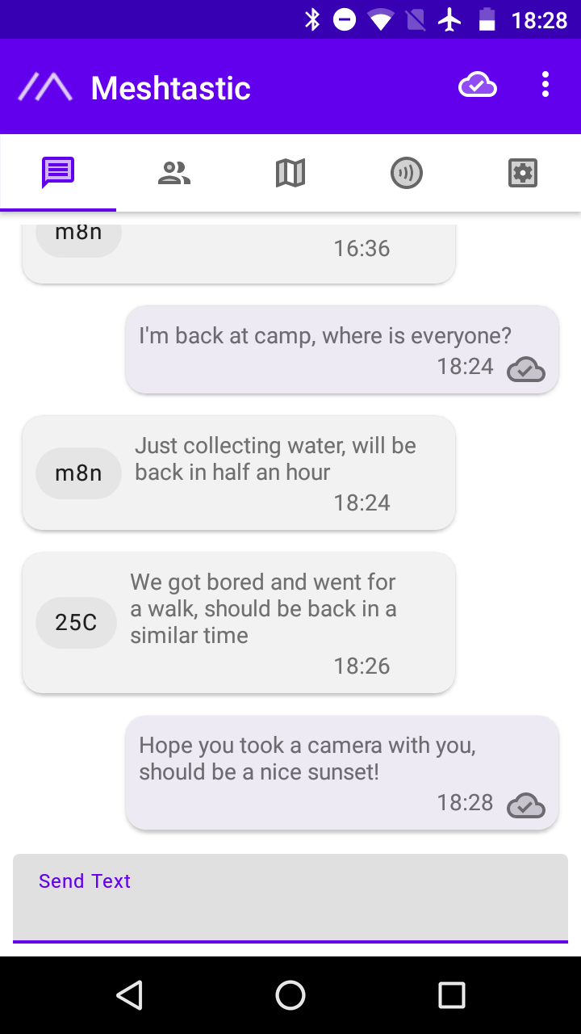
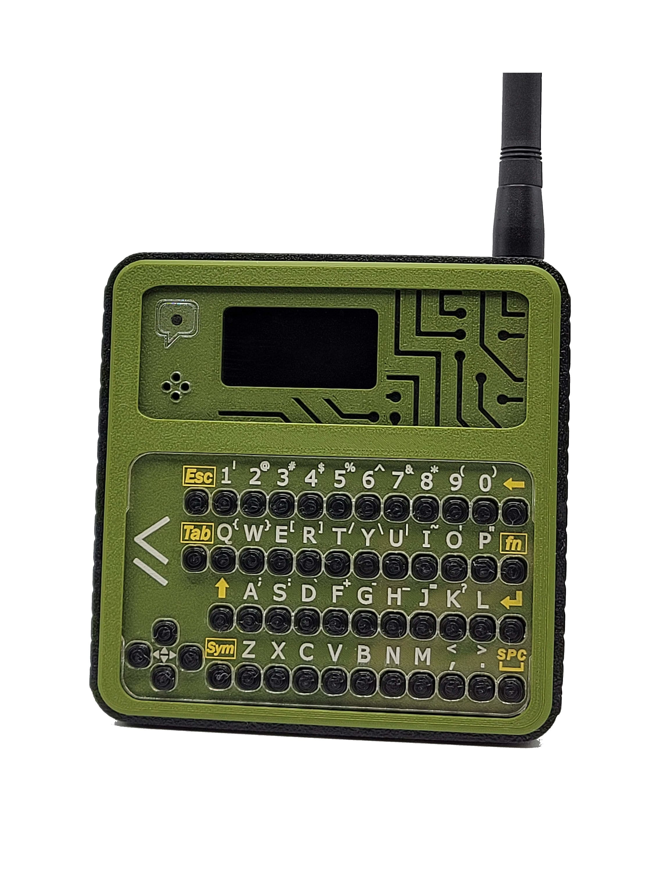

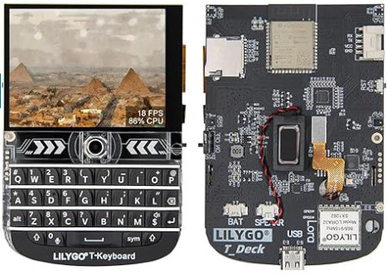


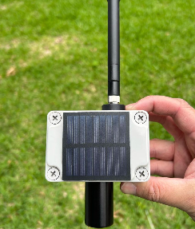
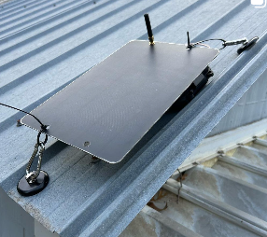

What is Meshtastic?
Cheap DIY Devices that work with your phone ($30-$50)
Decentralized Wireless Mesh Network
No Internet or Cell Coverage Needed
Standalone Devices that work without your phone ($70-$200)
FCC
Open Source
No License Needed
AES 256
Encrypted
iPhone and Android App
Solar Repeaters (~$200)

Slide 5
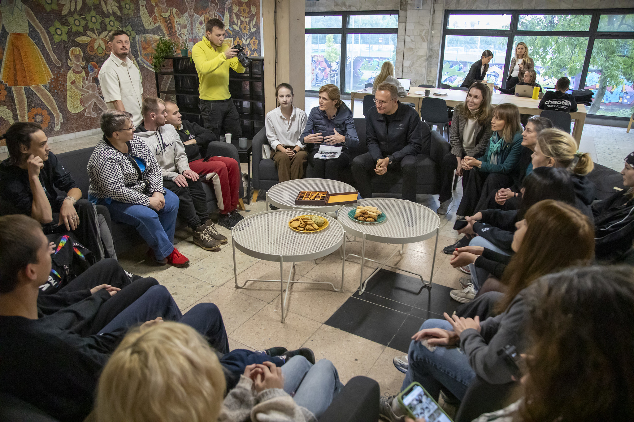
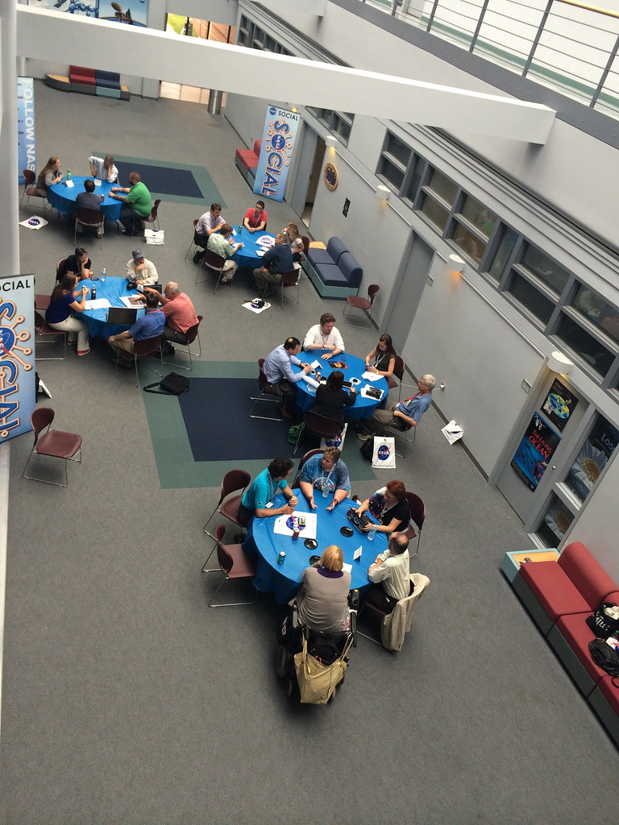
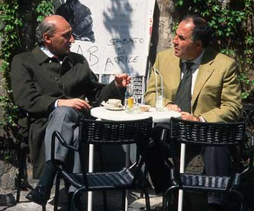
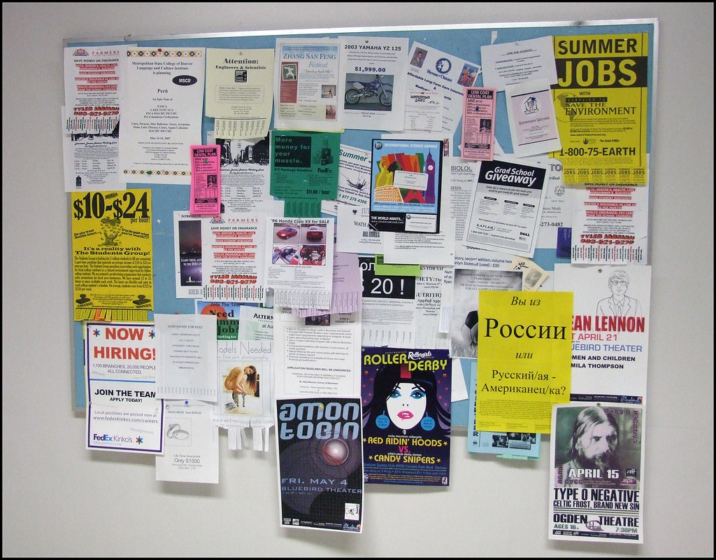
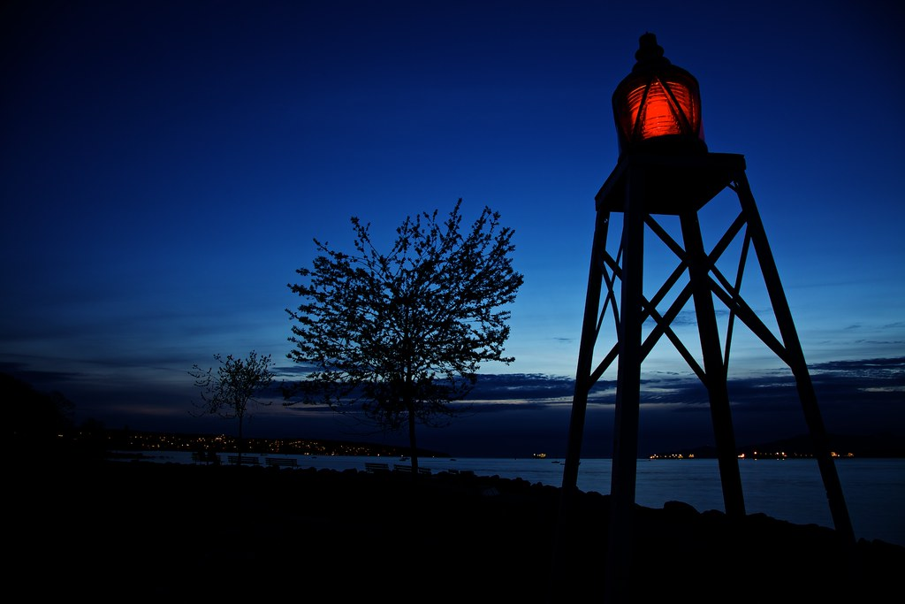
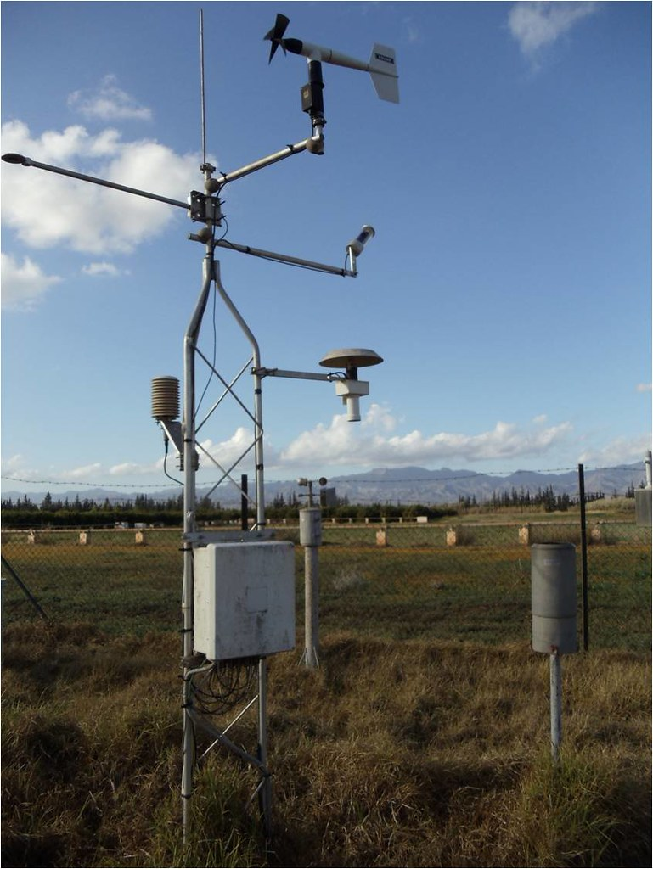
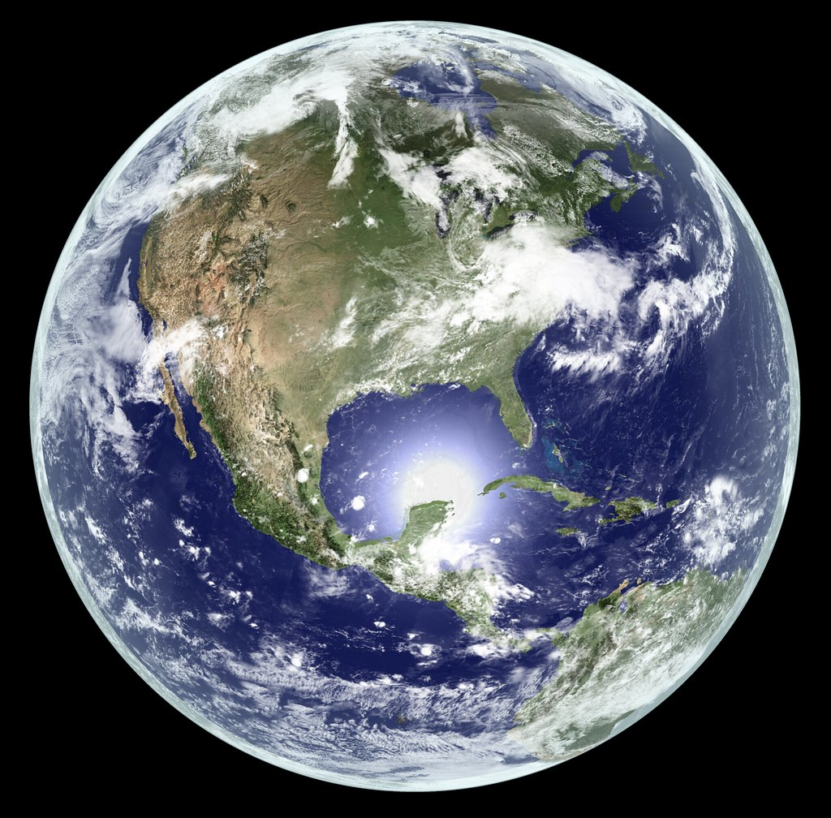
What can it do?
Unencrypted
Primary Channel
Encrypted
Group Channels
Encrypted
Direct Messages
Bulletin Board System (BBS)
Beacon
Location
Telemetry Data
Connect Worldwide on MQTT
Creative Commons Photo Attribution: Jeffrey Beall, James Webb Space Telescope, Elizabeth Buie, Hub☺, USAID_IMAGES, Kevin M. Gill

Slide 6
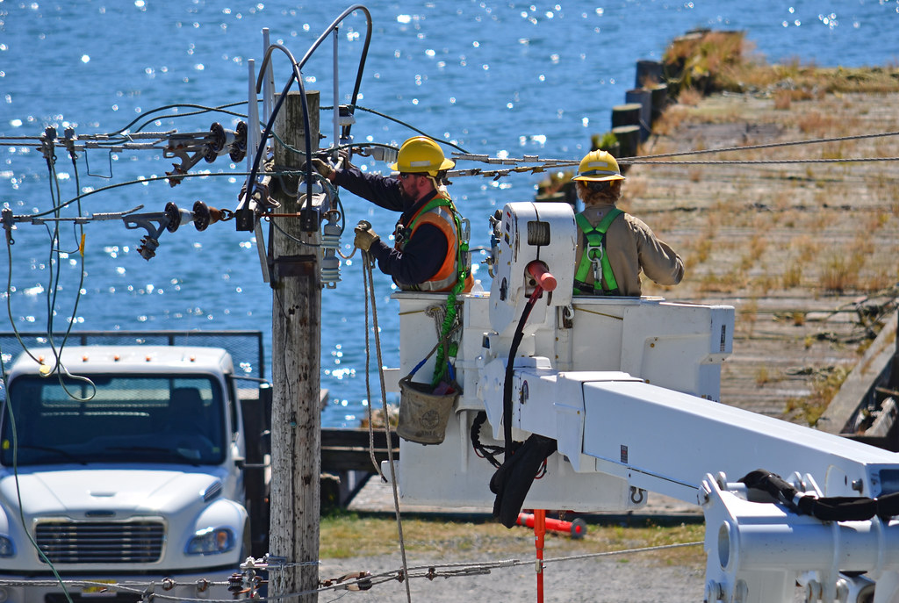
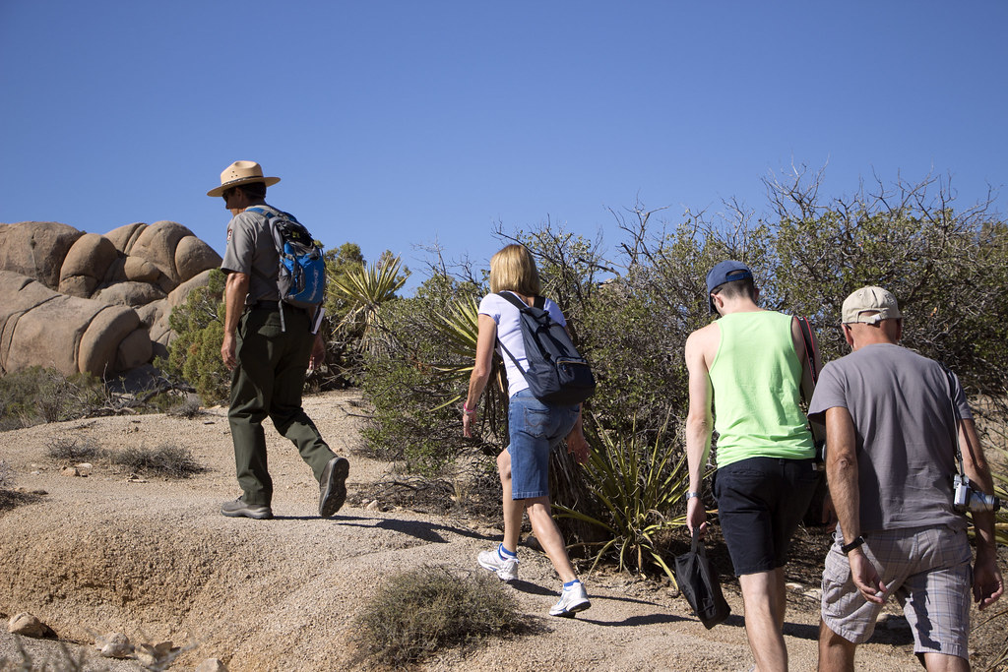
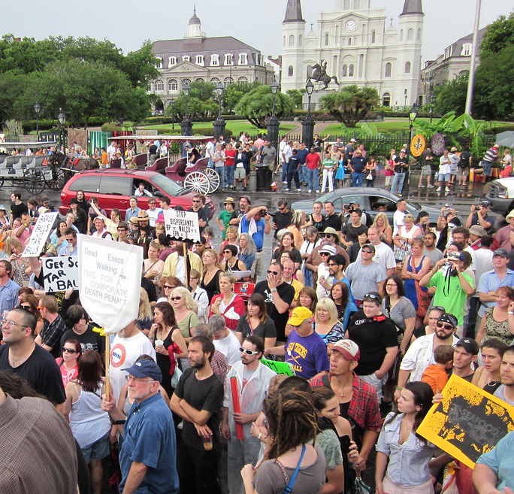
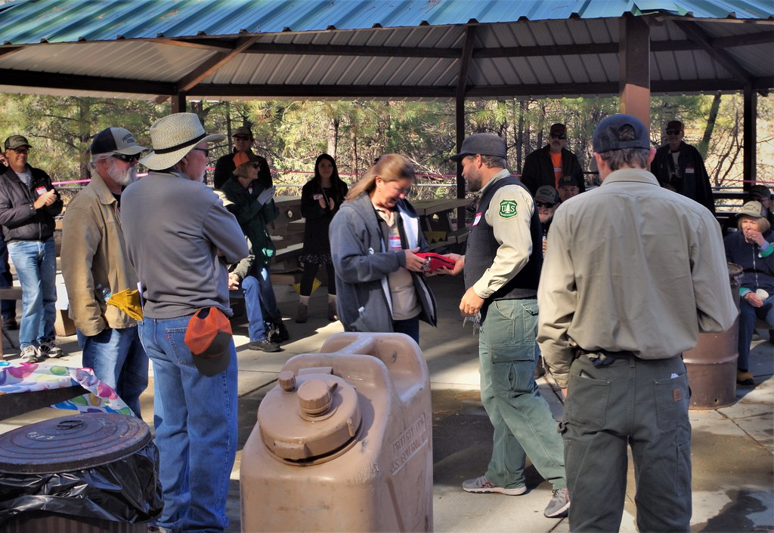
Use Cases
Disasters
Off-Grid, Hiking, Sailing, Hunting, Airsoft, Festivals, etc.
War, Protests, Civil Unrest, Internet Shutdown
Community
Building
Creative Commons Photo Attribution: jkbrooks85, Joshua Tree National Park, Infrogmation, Prescott NF

Slide 7
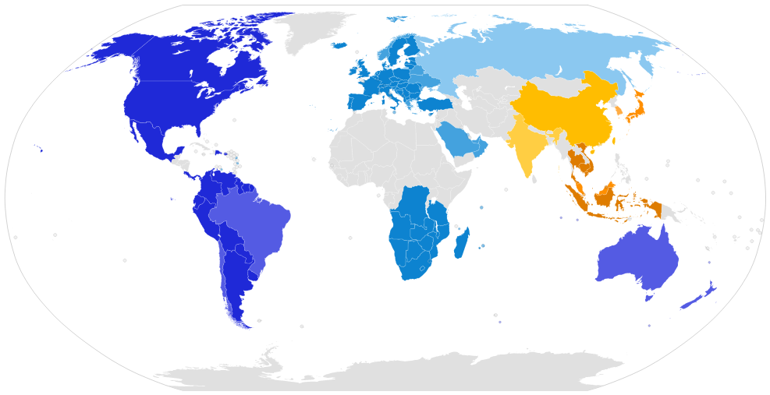
Uses ISM Bands – 915 MHz (902 to 928) in USA
Region | Frequency | Max ERP (Effective Radiated Power) | Duty Cycle Limit
Western Hemisphere | 902 to 928 MHz | +30 dBm ERP | No limit
Europe | 869.40 to 869.65 MHz | +14 dBm ERP | 10%
Asia | 433 to 434 MHz | +14 dBm ERP | No limit

Slide 8
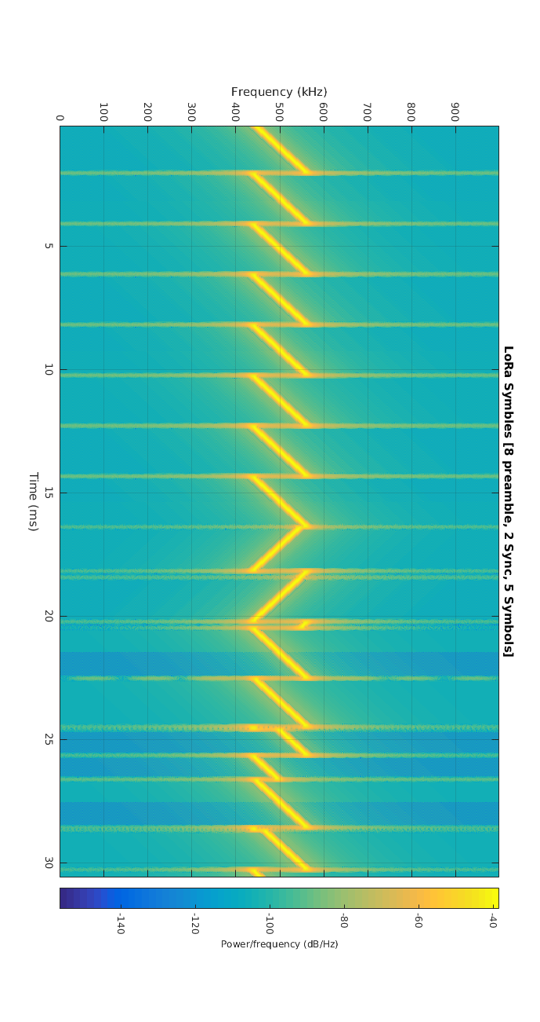
Chirp Spread Spectrum Modulation
Waterfall
LoRa Protocol
Long Range, Low Power, High Bandwidth, Medium Data Rate
250 kHz
bandwidth
LoRa is most similar to APRS over 2 meters
It is line of sight, but some links have gone hundreds of miles. It has similar data speed, but uses more bandwidth, so it can cut through the noise more easily. It has up to 160 dB of link budget (default 148.5 dB) with up to +30 dBm ERP
Meshtastic used flood routing meaning all nodes repeat all packets, just like APRS. It’s inefficient but reliable and requires low computational overhead.
Meshtastic Channels
Meshtastic Channel | Data-Rate (kbps) | Bandwidth (kHz) | Link Budget (dB) | Note
custom | 37.50 | 500 | 129 | Fastest possible speed
Short Range / Fast | 6.8 | 250 | 137
Short Range / Slow | 3.9 | 250 | 140
Medium Range / Fast | 2.2 | 250 | 143
Medium Range / Slow | 1.2 | 250 | 146
Long Range / Fast | 0.67 | 250 | 148.5 | Default
Long Range / Moderate | 0.335 | 125 | 151
Long Range / Slow | 0.18 | 125 | 154
Very Long Range / Slow | 0.09 | 62.5 | 157
custom | 0.046 | 31 | 160 | Twice the range of "Long Slow", high resilience to noise
“Preamble”
8 upsweeps
Tells other radios to listen up
Timing Sync
2 downsweeps
Message

Slide 9
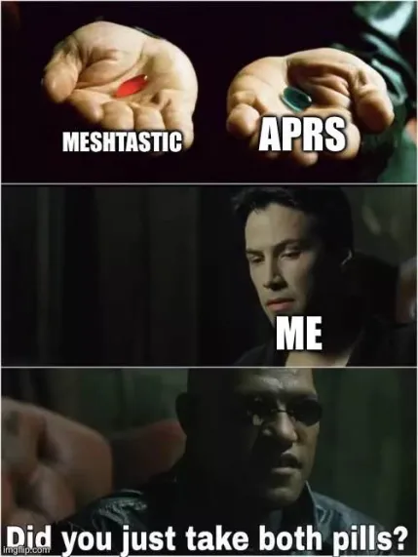
APRS vs Meshtastic
 | License | Encrypted | Routing Protocol | Radio Protocol | Data Burst (seconds) | Data Rate (bps) | Bandwidth (kHz)
APRS | Needed | No | Flood | AX.25 | 0.3-0.5 sec | 1200 | 13
Meshtastic | Not Needed | Yes | Flood | LoRa | 3 sec | 670 | 250
 | Internet Gateways | Repeaters | Services | Groups | Mapping | Telemetry
APRS | iGate | Digipeaters | Email, Weather, etc. | ANSRVR | Yes | Yes
Meshtastic | MQTT | Every node! | BBS | Channels | Yes | Yes

Slide 10
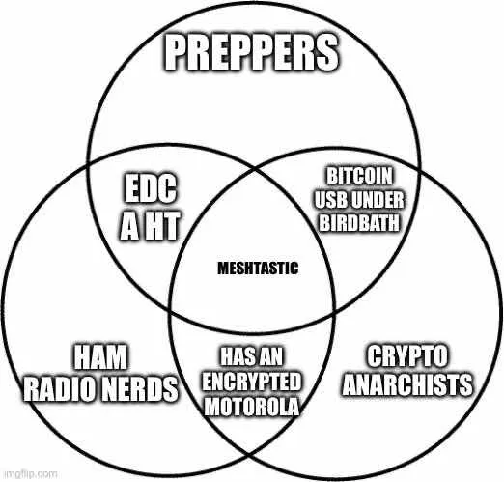
Using Meshtastic as a Licensed Ham
Radio name is Call Sign – broadcast every 10 minutes
“Each amateur station, except a space station or telecommand station, must transmit its assigned call sign on its transmitting channel at the end of each communication, and at least every 10 minutes during a communication…”
See FCC Part 97.119.A
Up to 10 Watt transmit power
Hams are normally limited to 1500 watts
However, when operating Spread Spectrum, hams are limited to 10 Watts PEP
See 47 CFR 97.313(j)
No encryption allowed
“No amateur station shall transmit”… “messages encoded for the purpose of obscuring their meaning”
See FCC Part 97.113.A.4

Slide 11
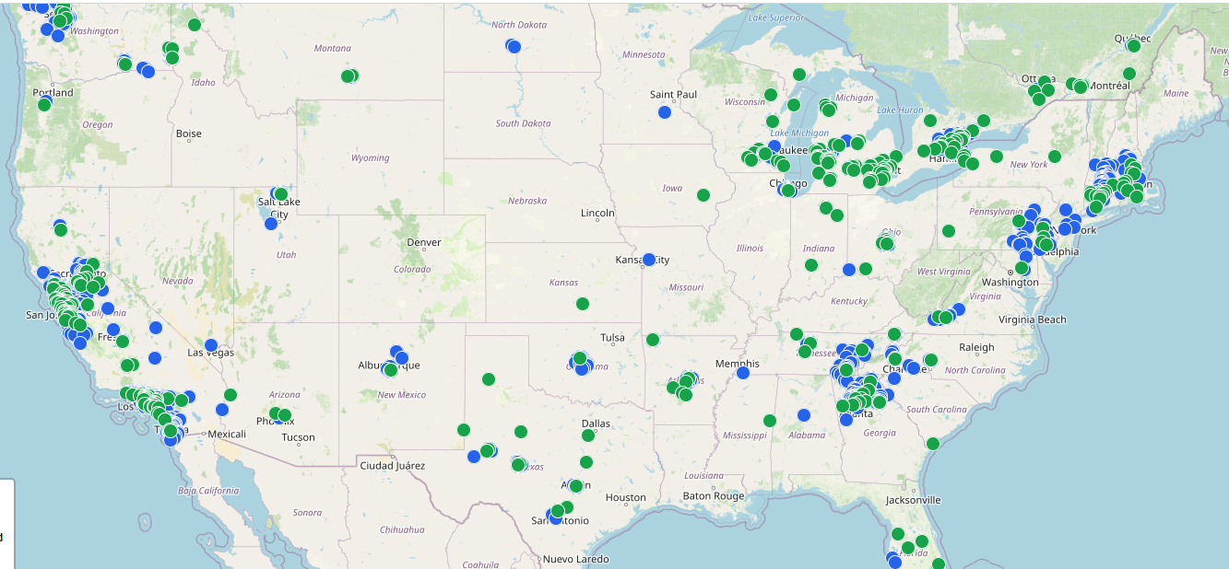
Status Globally
Thousands of nodes. Very large meshes in places like Calgary, SF Bay Area, Los Angeles, and the DC to New York corridor
https://meshtastic.liamcottle.net

Slide 12
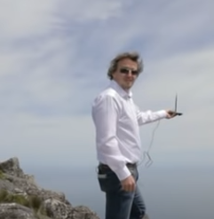
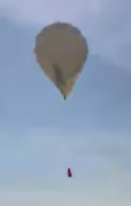
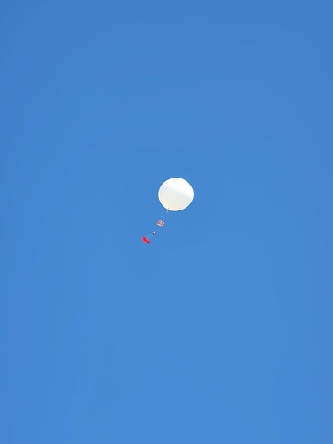
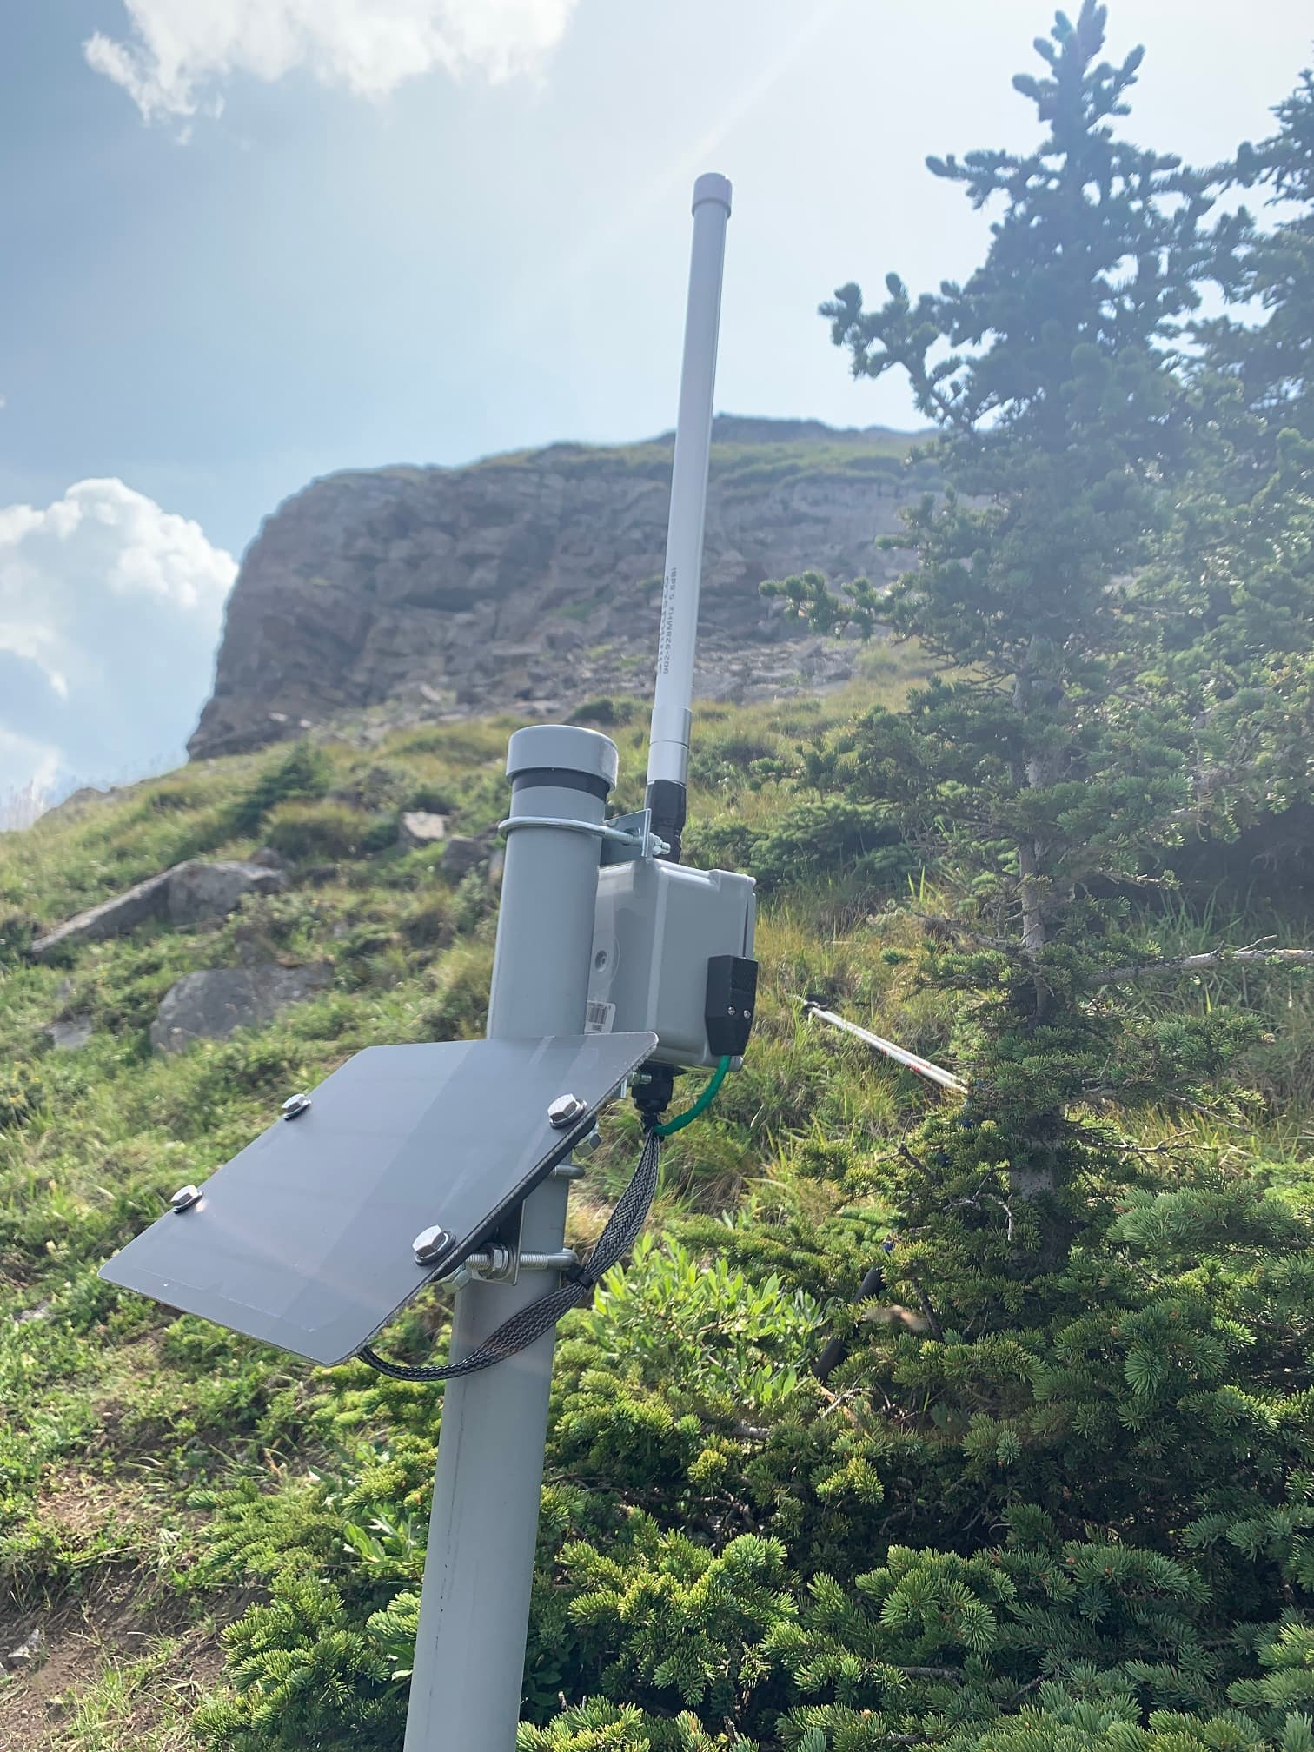
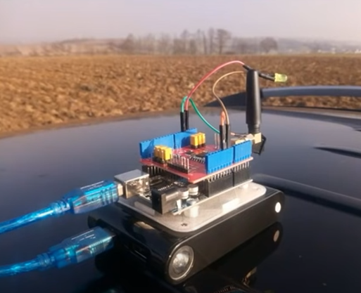
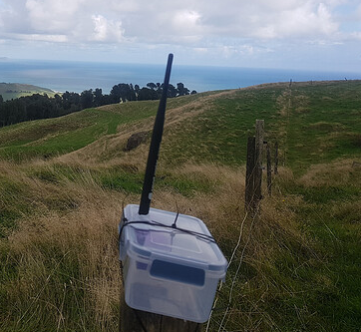
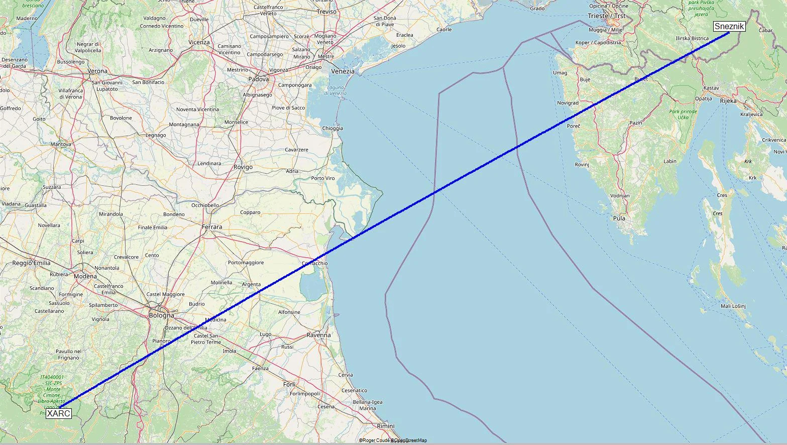
Propagation Records
Photo
Miles | 62 | 124 | 436 | 103 | 128 | 158 | 205
Date | Mar 2015 | Feb 2017 | Sept 2017 | April 2021 | May 2023 | July 2023 | Oct 2024
Who | Richard Wallace & Rodney Farrow | Andreas Spiess (HB9BLA) | Thomas Telkamp & Laurens Slats | PuzzledPancake | StarWatcher, CVR, rook, & kboxlabs | Kboxlabs | MartinR7 & alleg
Where | Across a bay in South Africa | Swiss Mountain | Balloon at 127,205 feet over Poland | Across a bay in New Zealand | Balloon over Alberta | Hailstone Butte, Canada | Mountain Top to Mountain Top, Italy
Protocol | LoRaWAN | LoRaWAN | LoRaWAN | Meshtastic | Meshtastic | Meshtastic | Meshtastic
Hardware | TI CC112x | RAK831 | Lacuna Space | LILYGO T-Beam | LILYGO T-Beam | RAK4631 | RAK4631, 2.8 dBi antenna

Slide 13
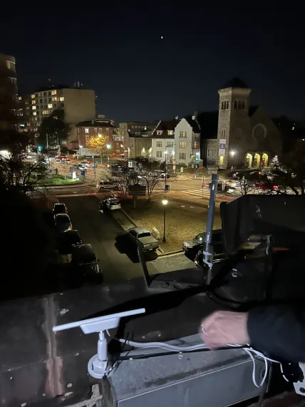
Solar Powered Repeaters
We have a solar powered repeater at HacDC that has been running non-stop without intervention for >3 months (since Dec 17 2024). This node uses a design that was iterated at Austin Mesh, where we found:
What doesn’t work:
RAK’s built-in solar charge controller with 18650 batteries
Completely watertight cases
What works:
Battery and solar panel: Voltaic V25 battery pack, 10+ watt USB-C solar panel
Antenna: fiberglass
Chip: Rak
Case: waterproof with weep vent

Slide 14
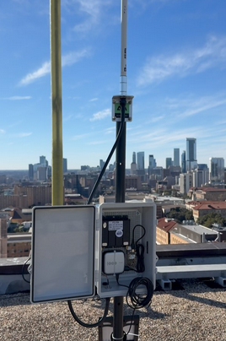
Solar Powered Repeater Parts List
Item | Product Name | Cost
Solar Panel | Soshine 12W | $30
Battery | Voltaic Systems V25 | $44
Rak Board | RAK Meshtastic Kit | $37
Antenna Connector | IPEX to N Type Female | $4
Antenna | 915 MHz 3 dBi N-Female | $39
Box | ABS Box with mounting tabs, 158mm x 90mm x 46mm | $9
Drain Plug | VENT-PS1YBK-N8001 | $5
USB Cable Pass-Through | 3/4 NPT Cable Gland | $2
Antenna Wrap | Proxicast | $2
Coax Cable | 3' KMR400 N Female to N Male | $13
 |  | $185

Slide 15
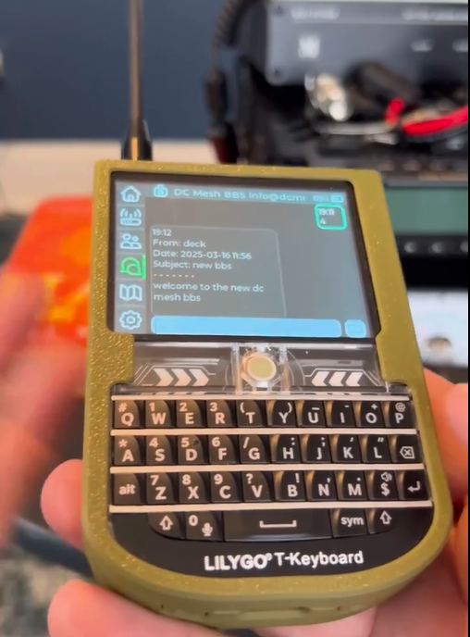
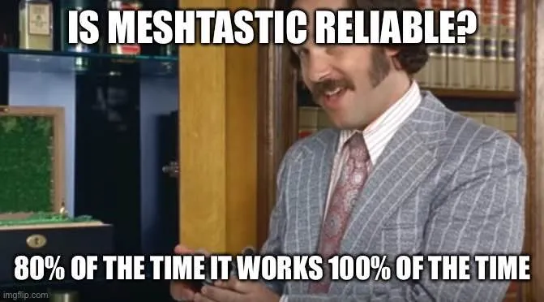
Bulletin Board System (BBS)

Slide 16
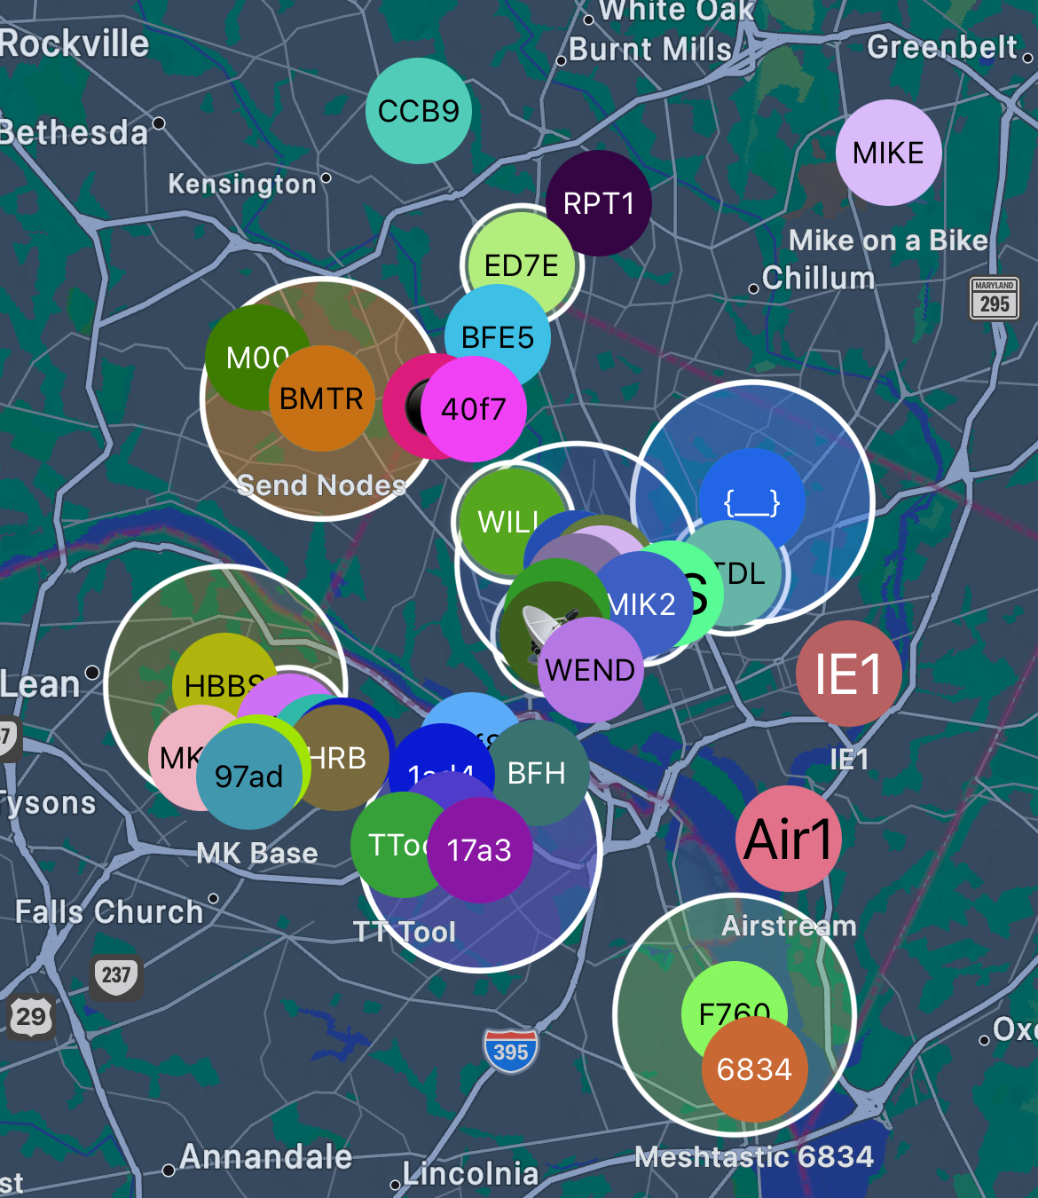
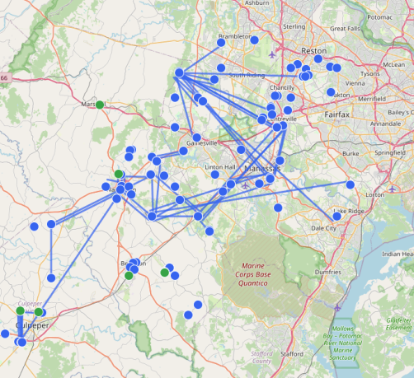
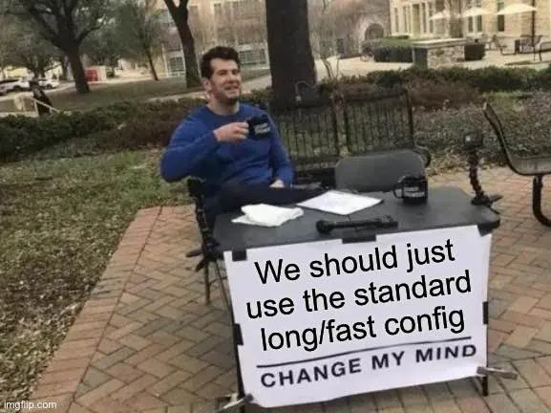
Expansion into Virginia
DC mesh uses the default channel (LongFast Slot 1: 902.125 MHz). We coverage into Virginia now.
A number of users in Virginia (NoVa Mesh) are using a non-default channel (LongFast Slot 9: 904.125), so it doesn’t mesh up with the rest of the United States.

Slide 17
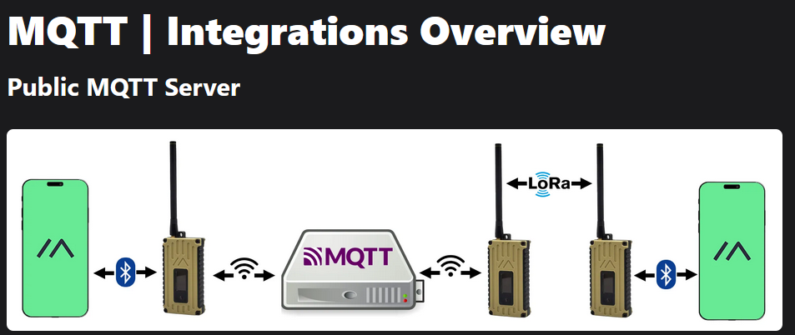
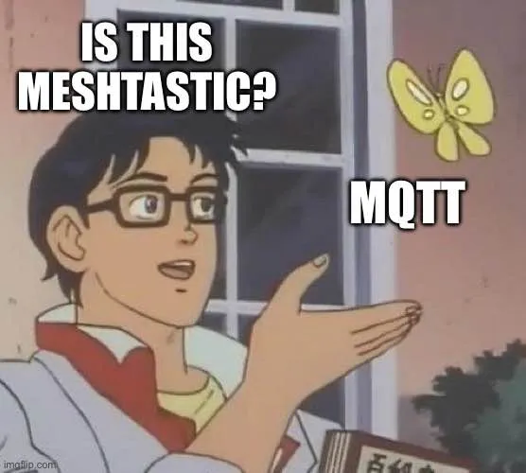
Help Wanted! Let’s mesh the two networks
Meshtastic has a system in place for bridging these types of meshes that are on different frequencies. If anyone would like to help – please let me know!

Slide 18
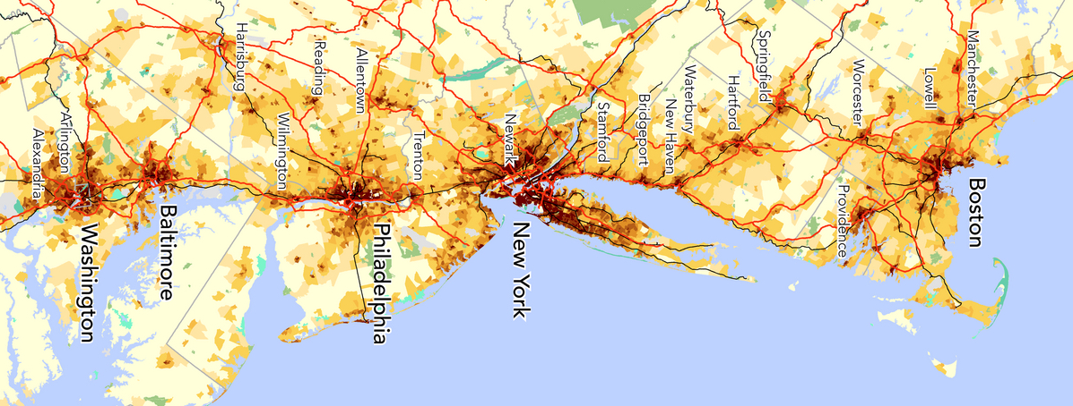
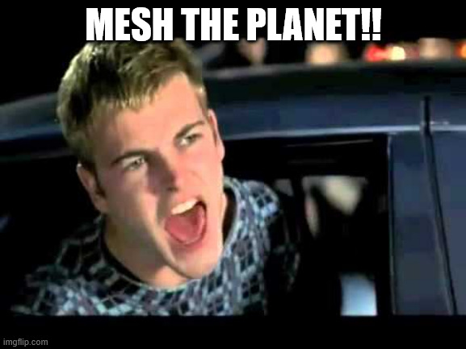
Longer-term expansion
The Northeast megalopolis has a population of 50 million people over a distance of 450 miles. It is possible to slowly mesh up this entire corridor.

Slide 19
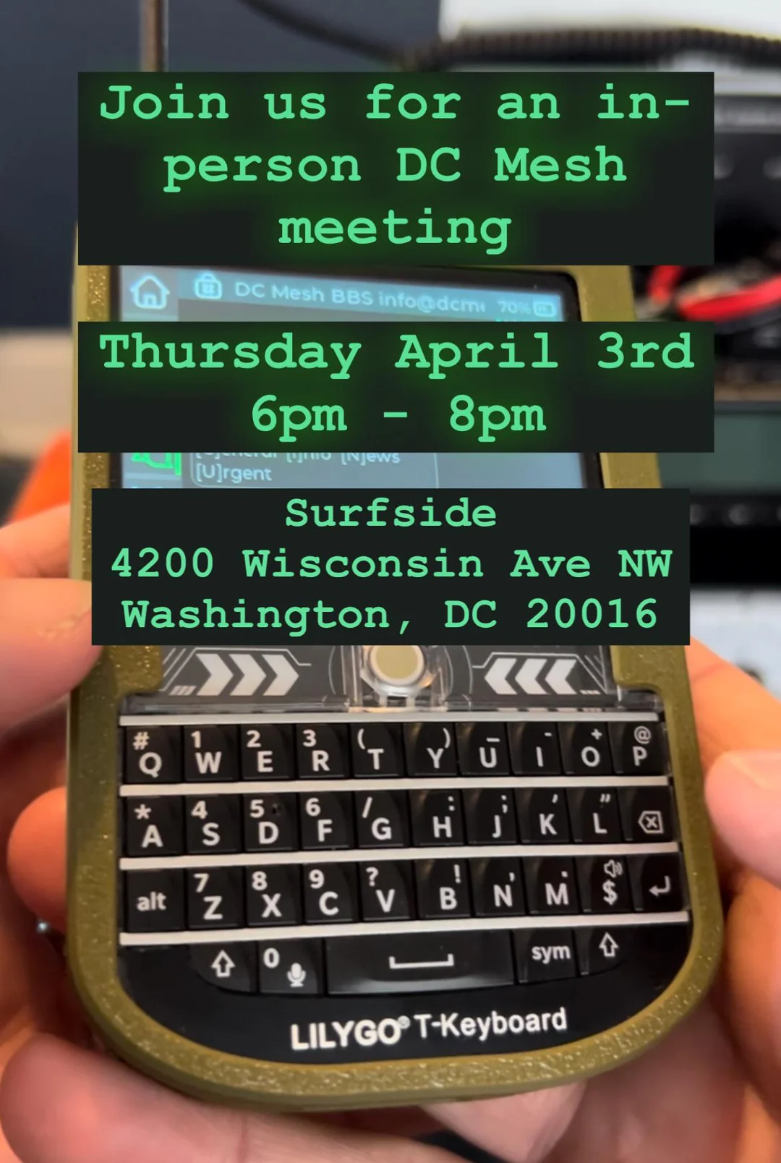



Join us!
Discord: Invite link at DCmesh.org
Socials: @dcmeshorg & @dcmesh.org
Quarterly In-Person Meetings
Other DC Area Clubs:
DMV Mesh: on Reddit (r/Meshtastic_DMV_Users/)
NoVa Meshtastic: https://groups.io/g/NoVa-Meshtastic

